Slide 1
Amazon Sales Data Analysis
Detailed Project Report
By:- Gautam Mahto

Slide 2
Project Detail
Project Title | Amazon Sales Data Analysis
Technology | Business intelligence
Domain name | E-Commerce
Project Difficulties Level | Advanced
Tools | Jupyter notebook, Power Bi, Ms Excel, Ms PowerPoint, Ms Word.

Slide 3
OBJECTIVE
Finding Sales & Profit Trend month wise , year wise , yearly month wise

Slide 4
PROBLEM STATEMENt
Sales management has gained importance to meet increasing competition and the need for improved methods of distribution to reduce cost and to increase profits. Sales management today is the most important function in a commercial and business enterprise.
Do ETL : Extract-Transform-Load some Amazon dataset and find for me Sales-trend -> month wise , year wise , yearly-month wise.
Find key metrics and factors and show the meaningful relationships between attributes.

Slide 5
Architecture
Data Preprocessing
Raw Data Collection
Importing Libraries in Jupyter Notebook
Load Datasets
Missing Value Imputation
Handling Outliers
Data Cleaning
Real World
Deployment
Insights
PowerBi Desktop
Modelling
Exploratory Data Analysis (EDA)
Reporting

Slide 6
DATASET INFORMATION
This is a Sales related dataset that contains Information like Sales Amt., Cost Amt., Sales Prices, List Prices, Sales Margins, Sales Quantities, etc

Slide 7
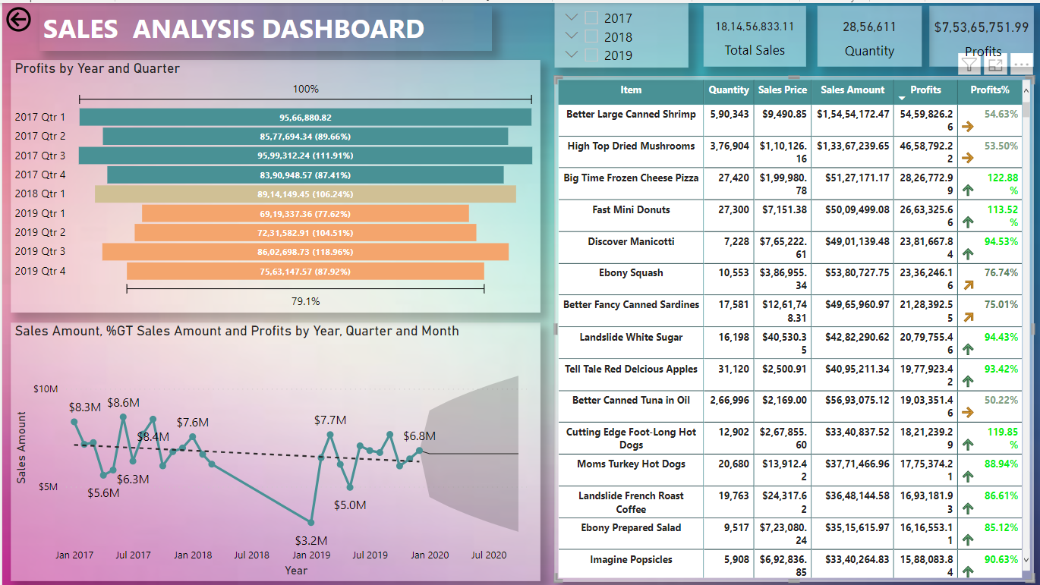
Sales & profit info

Slide 8
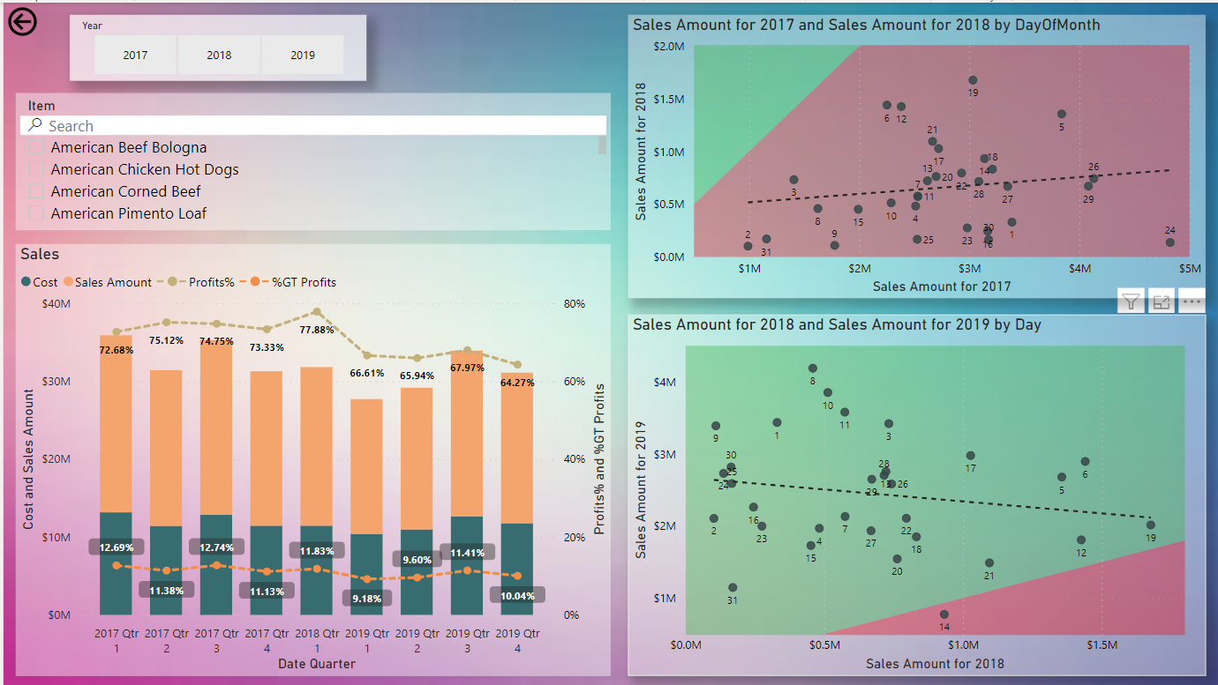
Sales Insights

Slide 9
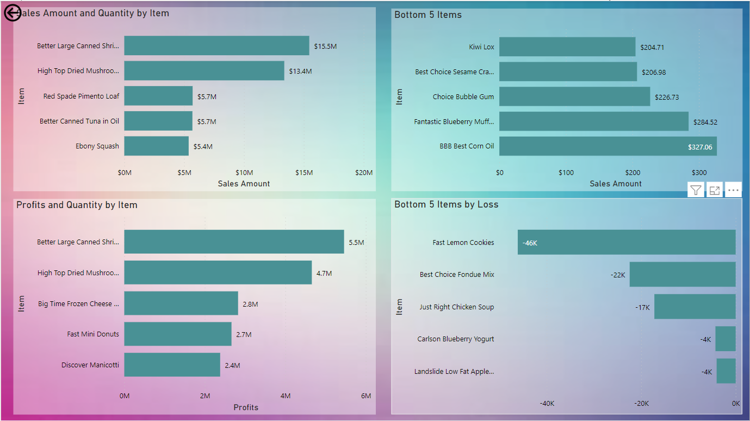
Top & Bottom Products

Slide 10
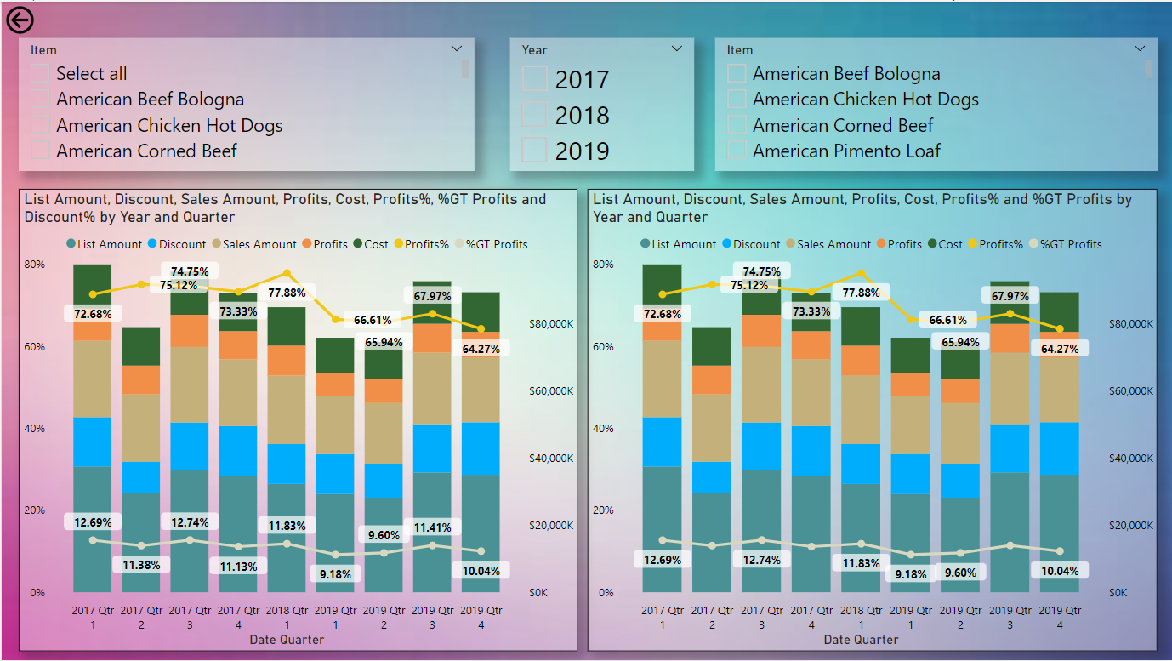
Item Comparision

Slide 11
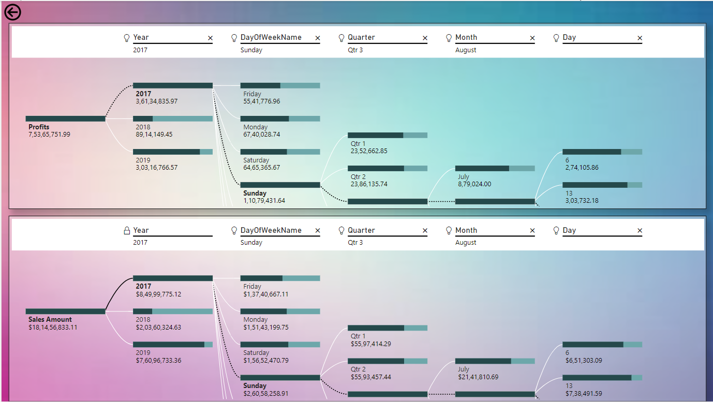
Detailed profit analysis

Slide 12
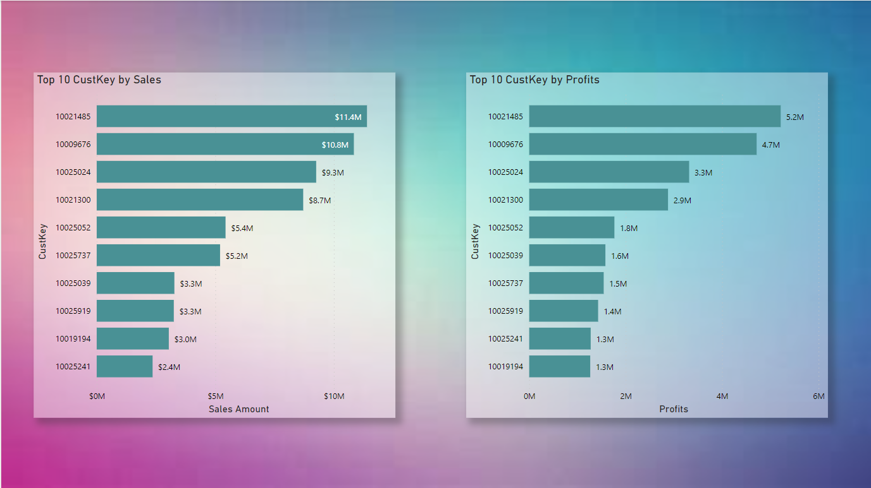
Top by custkey

Slide 13
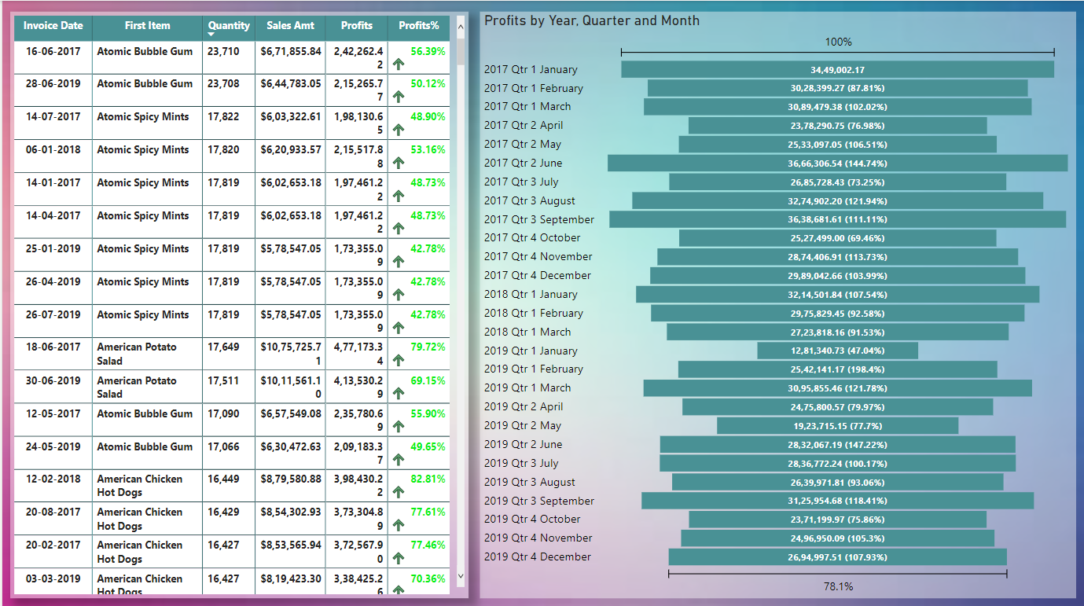
Sales Trend

Slide 14
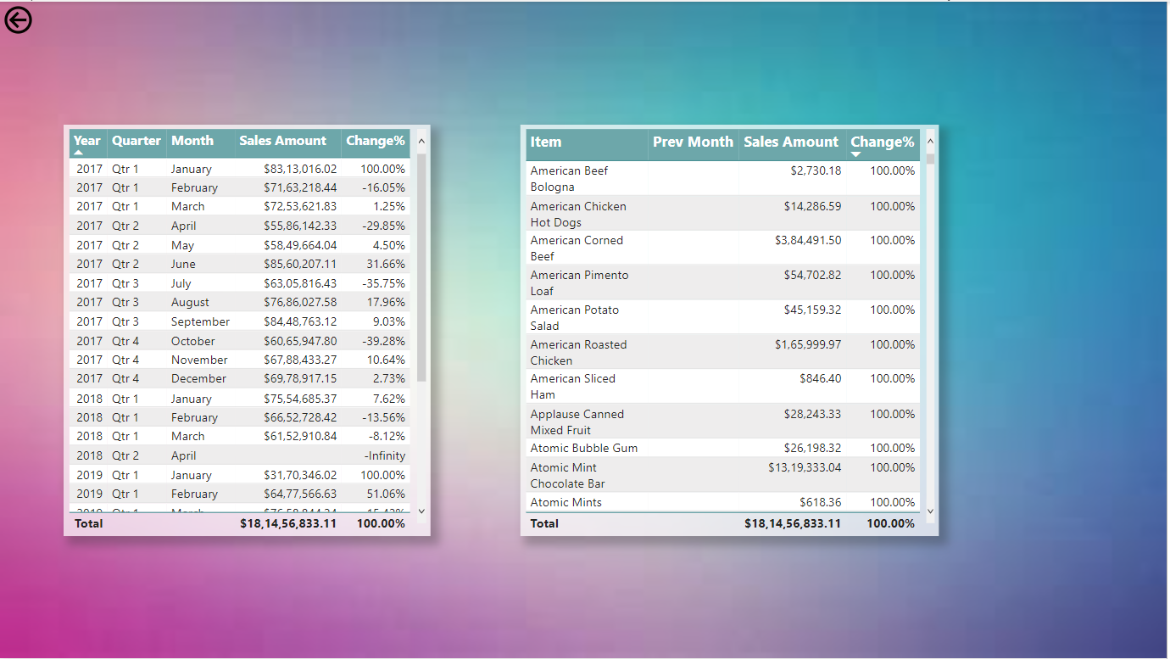
Monthly Records

Slide 15
QUESTIONS AND ANSWERS
Q1) What’s the source of data?
Ans) TheDataset wastaken fromiNeuron’sProvidedProject DescriptionDocument. https://docs.google.com/spreadsheets/d/1h3EsPf-fTLrzpP7sGeyuRnGBXrdJRcXY /edit?usp=sharing&ouid=105519103382792804653&rtpof=true&sd=true
Q2) What was the type of data?
Ans) Thedata was a combination of numerical and Categorical values.
Q 3) What was the complete flow you followed in this Project?
Ans) Referslide 5 th forbetter Understanding
Q4) What techniques were you using for data?
Ans) -Removing unwanted attributes.
-Visualizing relation of independent variables with each other and output variables.
-Checking and changing distribution of continuous values.
-Removing outliers -Cleaningdata and imputingifnull values are present.
-Transforming data to yield the desired result.

Slide 16
Thank You

